Slide 1
Learning Outcomes
This presentation will demonstrate how to …
code nav image links
produce opacity with CSS
designate RGBA and HSLA color with CSS
compare graphic types
plan for mobile applications
incorporate design principles into web pages

Slide 2
Image Link
Home
To create an image hyperlink use an anchor element to contain an image element
<a href="index.html"><img src="home.gif" height="19" width="85" alt="Home"></a>
Some browsers automatically add a border to image links.
Configure CSS to eliminate the border img { border-style: none; }

Slide 3
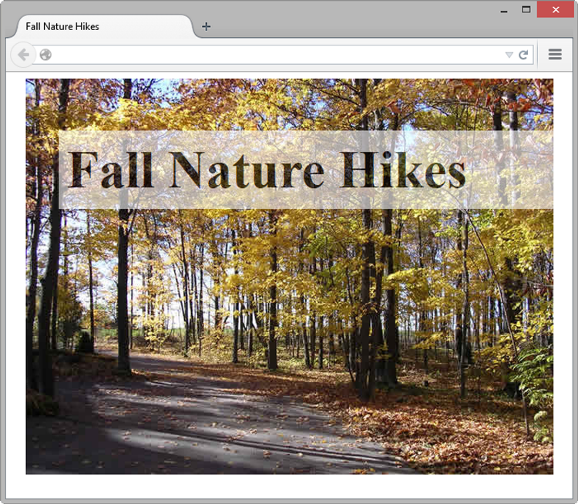
CSS3 opacity Property
Configure the opacity of the element
Opacity range:
0 Completely Transparent
1 Completely Opaque horizontal offset, vertical offset, blur radius, and valid color value
Example:
h1{ background-color: #ffffff;
opacity: 0.6; }

Slide 4
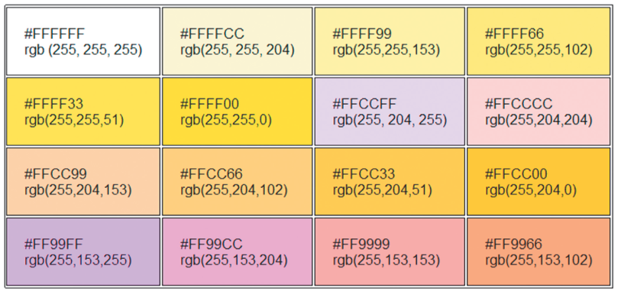
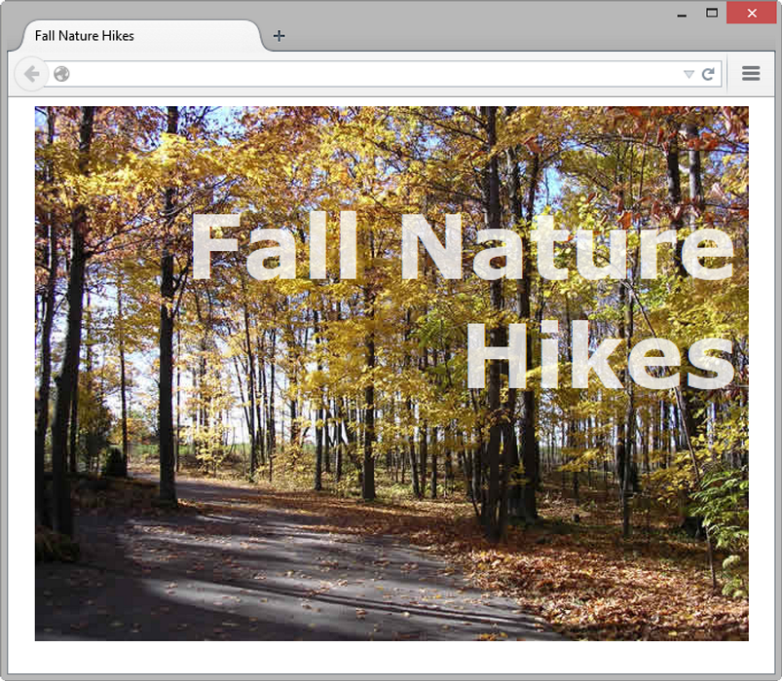
Rgba Color
Four values are required:
red, green, blue, alpha(transparency)
The values for red, green, and blue must be decimal values from 0 to 255.
transparency, recall, is from 0 to 1
color: #ffffff in rgba:
h1 {color: rgba(255, 255, 255, 0.7);
font-size: 5em; padding-right: 10px;
text-align: right; font-family: Verdana, Helvetica, sans-serif;
}

Slide 5
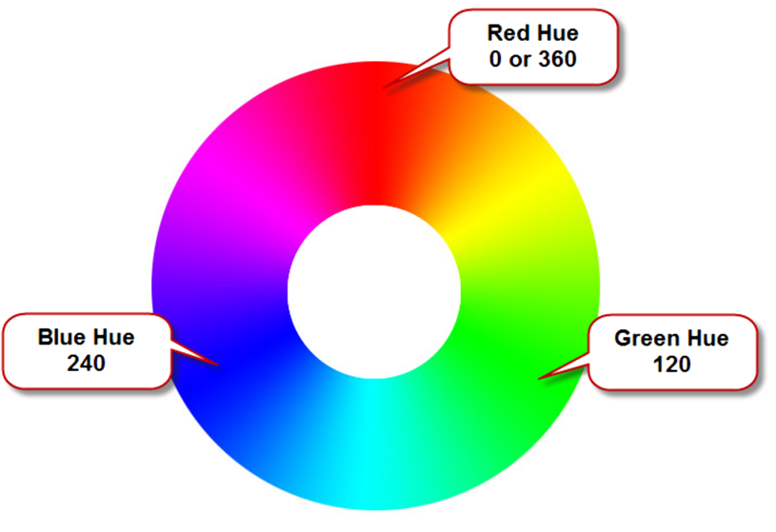
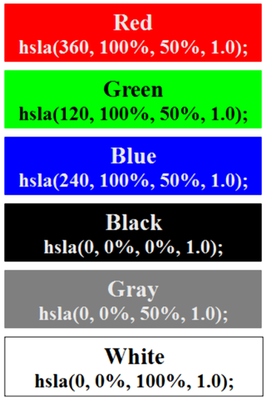
HSLA Color
Open thumbnails project for illustration
hue, saturation, light, alpha
Hue is a value between 0 and 360
(basic color)
Saturation: percent
(amount of gray in a color)
Lightness: percent
(adding white to a color: red to pink, for xmpl)
Optional alpha: from 0 to 1

Slide 6
Types of Graphics
Graphic types commonly used on web pages:
GIF -- Graphics Interchange Format (pronounced "jif")
JPG/JPEG -- Joint Photographic Experts Group
PNG -- Portable Network Graphic

Slide 7
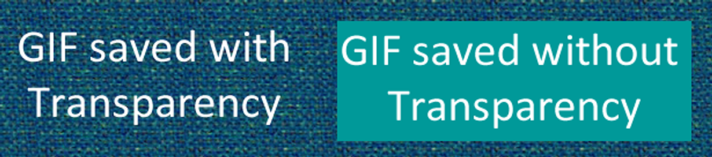

GIF
Background color – no transparency
Background color configured to be transparent
Best used for line art and logos
Maximum of 256 colors
One color can be configured as transparent
Can be animated

Slide 8


JPG/JPEG
Best used for photographs
Up to 16.7 million colors
Cannot be animated
Cannot be made transparent

Slide 9




PNG
Support millions of colors
Support multiple levels of transparency (but most browsers do not -- so limit to one transparent color for Web display)
Combines the best of GIF & JPEG
Browser support is growing
Comparison of file formats:
http://www.aivosto.com/vbtips/imageformats.html
Notes:
BMP: 32 bit color, or over 4 billion. GIF: 8 bits, 256 colors. JPEG: 24 bit, 16 million. PNG: 24 bit, 16 million

Slide 10
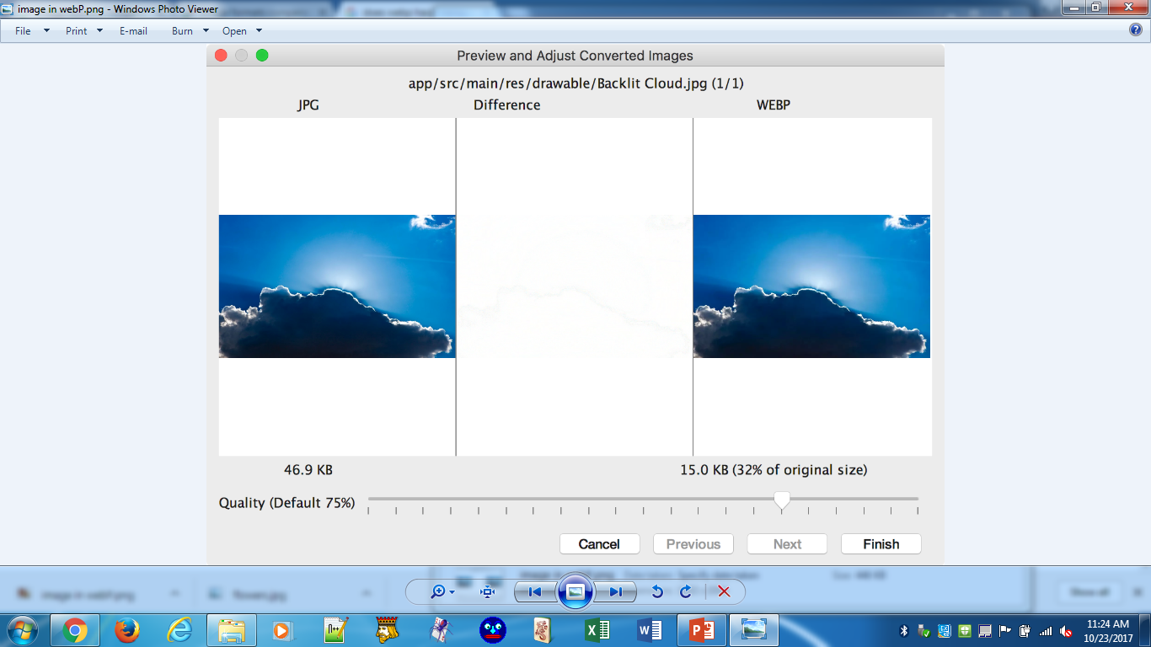

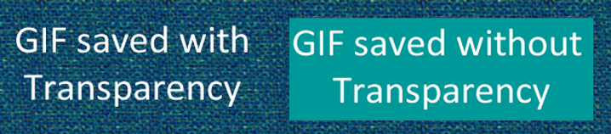
Image Formats Comparison
GIF
JPG
PNG
WebP
colors
256
16.7 m
16.7 million
16.7 m
transparency
single color
single color, alpha
yes
none
least quality loss & smallest file size
compression
low quality loss
smallest file size
deflate
animation
yes
no
yes
yes
browser support
chrome & opera
all
all
all
quick-load: line art, logos, & animation
photographs;
quality print
compressed photographs
best use
web not print
46.9 KB
15.0 KB (32% jpg)
Notes:
BMP: 32 bit color, or over 4 billion. GIF: 8 bits, 256 colors. JPEG: 24 bit, 16 million. PNG: 24 bit, 16 million
WebP introducted in 2016
Picture element provides hierarchy of image types (similar to font family options)

Slide 11
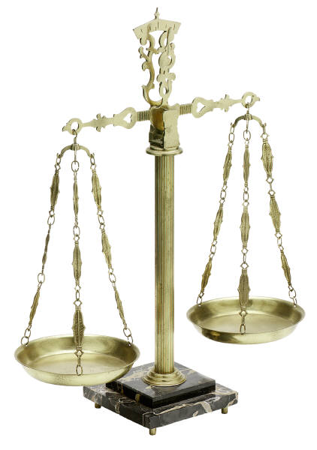
Choosing Names for Image Files
Use all lowercase letters
Do not use punctuation symbols nor spaces
Do not change the file extensions (should be .gif, .jpg, .jpeg, or .png)
Keep your file names short but descriptive
i1.gif is probably too short
myimagewithmydogonmybirthday.gif is too long
dogbday.gif is a plausible median

Slide 12

Mobile Web Limitations
Small Screen Size
Low bandwidth
Limited fonts
Limited color
Awkward controls
Lack of Flash support
Limited processor and memory
Cost per kilobyte

Slide 13
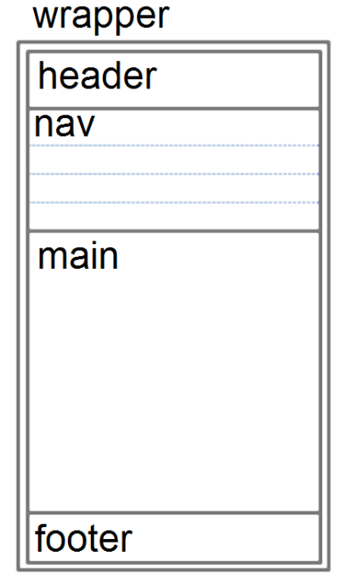
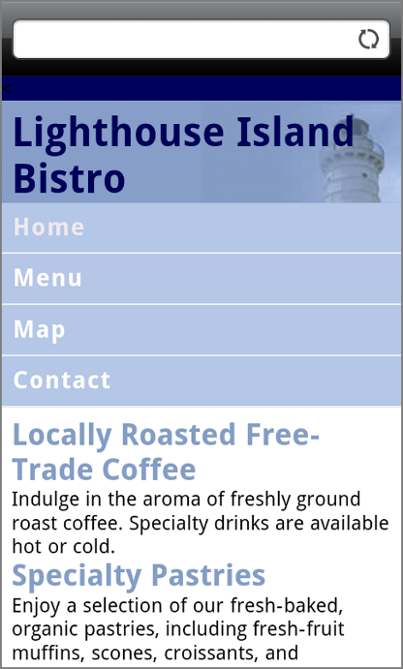
Optimize Layout for Mobile Use
Single column design
Limit scrolling to one direction
Use heading elements
Use lists
Avoid using tables
Provide labels for form controls
Avoid using pixel units in style sheets (% instead)
Avoid absolute positioning in style sheets
Hide content that is not essential for mobile use.

Slide 14

Optimize Navigation for Mobile Use
Provide minimal navigation near the top of the page
Provide consistent navigation
Avoid hyperlinks that open files in new windows or pop-up windows
Try to balance both the number of hyperlinks on a page and the number of levels needed to access information

Slide 15
Optimize Graphics for Mobile Use
Avoid displaying images that are wider than the screen width
Configure alternate, small optimized background images
Some mobile browsers will downsize all images, so avoid using images that contain text
Avoid the use of large graphic images
Specify the size of images
Provide alternate text for graphics and other non-text elements.

Slide 16
Optimize Text for Mobile Use
Configure good contrast between text and background colors
Use common font typefaces
Configure font size with em units or percentages
Use a short, descriptive page title

Slide 17
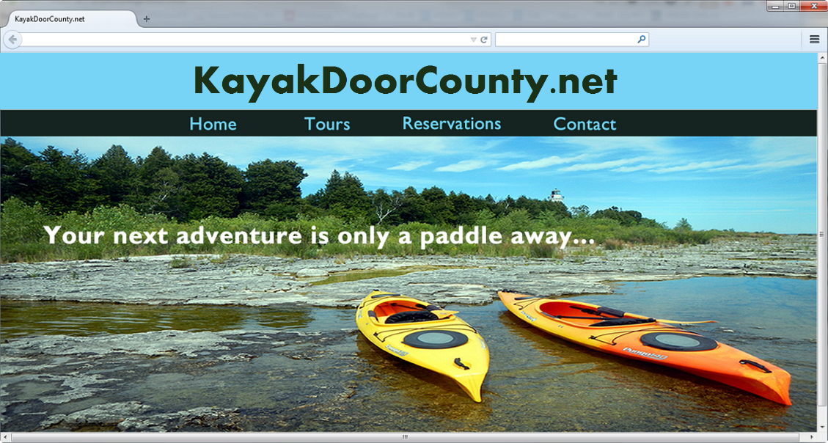
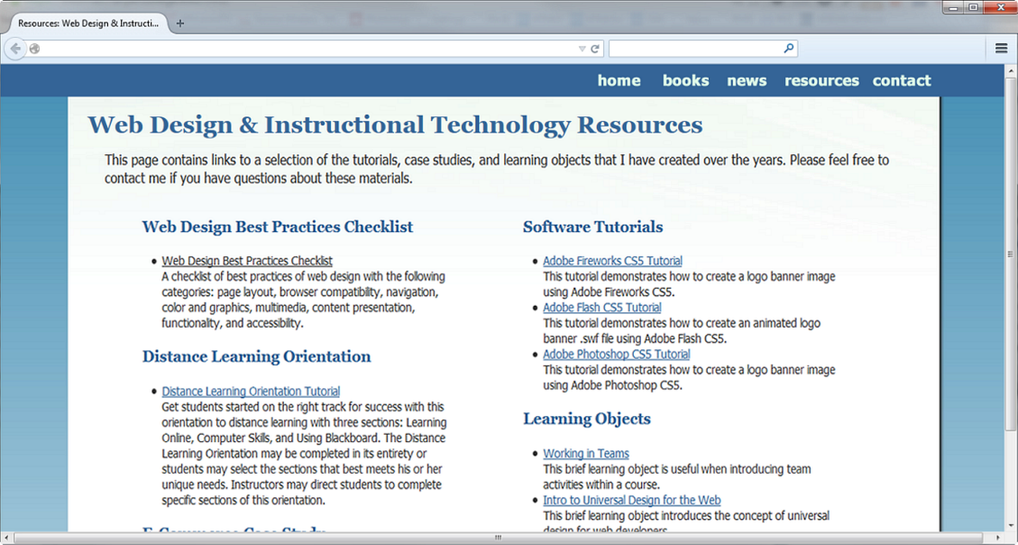
Design Principles
Overall Design Is Related to the Site Purpose
Consider the target audience
of these sites.
Notes:
Regardless of your personal preference, design for the audience: kids, college students, young couples, seniors, etc.
Purposes/goals of audience: pleasure, research, shopping, job hunting, learning, etc.

Slide 18
Website Organization
Hierarchical
Linear
Random (sometimes called Web Organization)
Designing an enterprise site is typically a team project.
-may meet in a room with a pad of post-it notes and a white board
-write down the main titles or topics for the site
-arrange / rearrange until there is consensus for the site structure

Slide 19
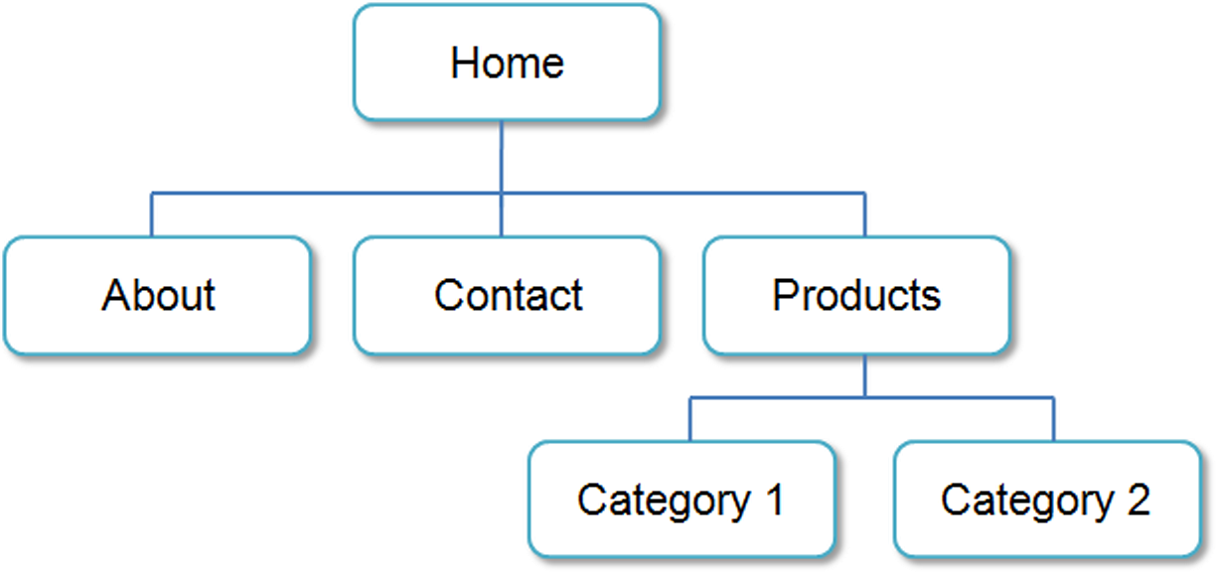
Hierarchical Organization
A clearly defined home page
Navigation links to major site sections
Often used for commercial and corporate websites

Slide 20
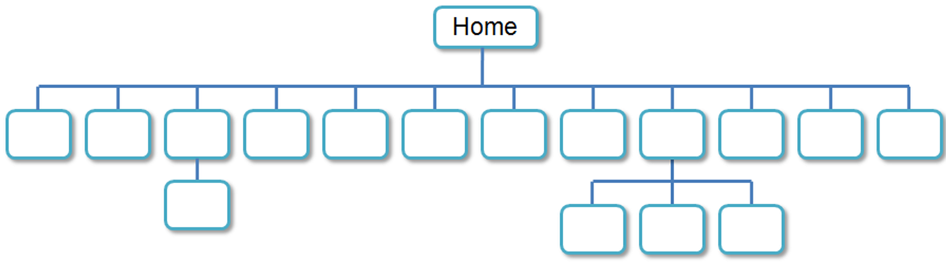
Hierarchical Pitfall -- TOO Shallow
Be careful that the organization is not too shallow.
Too many choices → a confusing and less usable web site
Information Chunking
Research by Nelson Cowan: adults typically can keep about four items or chunks of items in short-term memory (http://www.ncbi.nlm.nih.gov/pmc/articles/PMC2864034/)
Be aware of the number of major navigation links
Group navigation links visually into groups with no more than about four links.

Slide 21
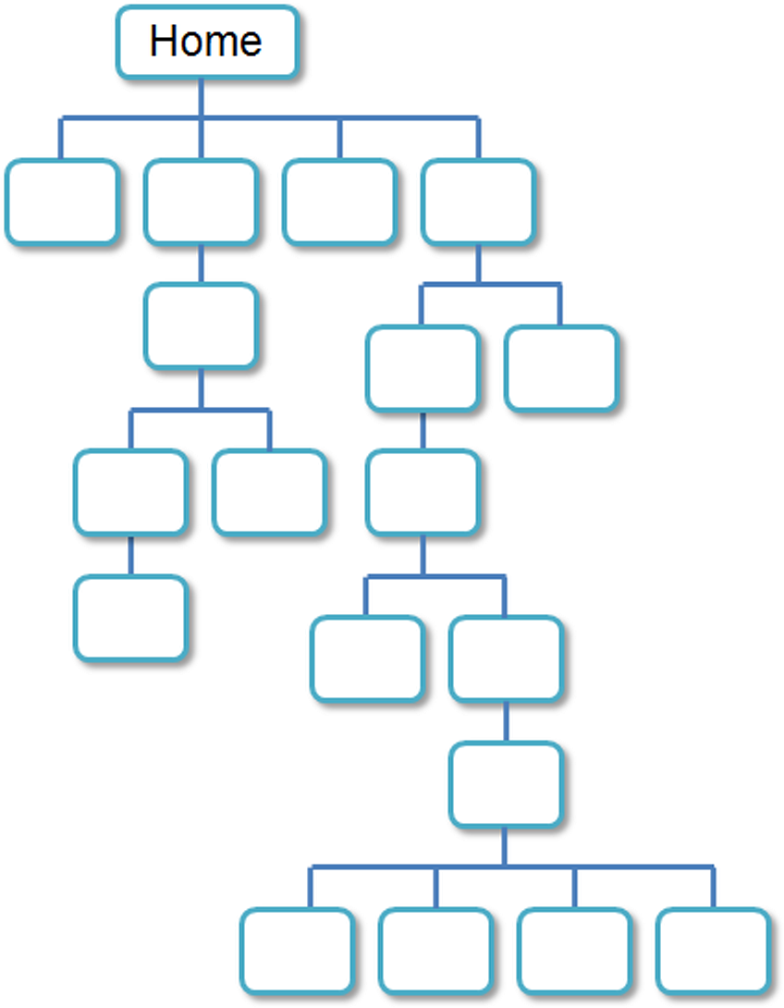
Hierarchical Pitfall -- TOO Deep
Be careful that the organization is not too deep.
This results in many “clicks” needed to drill down to the needed page.
User Interface “Three Click Rule”
A web page visitor should be able to get from any page on your site to any other page on your site with a maximum of three hyperlinks.

Slide 22
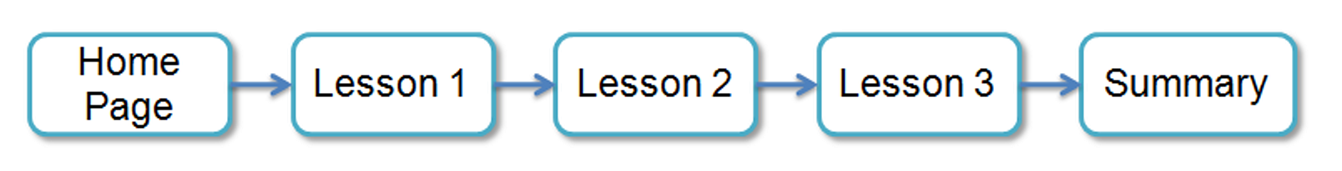
Linear Organization
A series of pages that provide a tutorial, tour, or presentation.
Sequential viewing

Slide 23
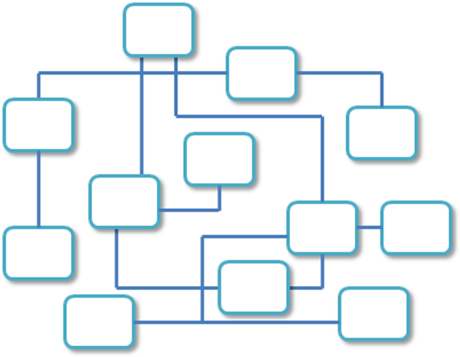
Random Organization
Sometimes called “Web” Organization
Usually there is no clear path through the site
May be used with artistic or concept sites where the intent is to be different and original
Not typically used for commercial sites.
Notes:
Random, or coding with "go to" used to be referred to as "spaghetti code"

Slide 24
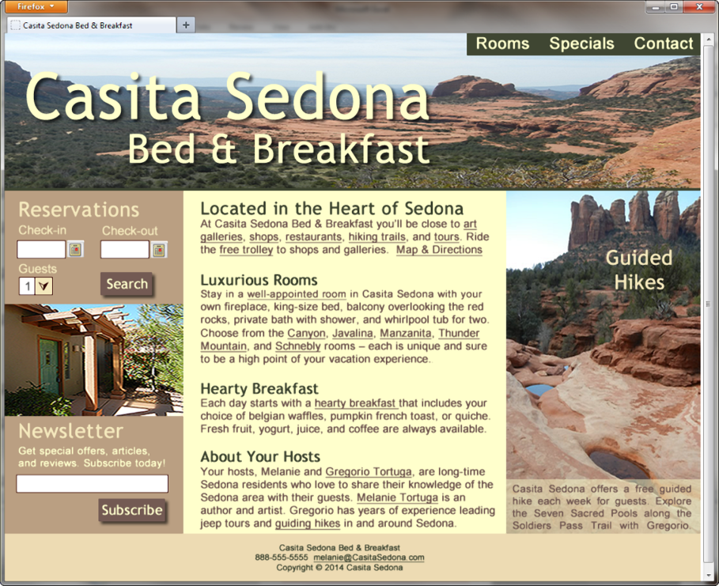
Design Principles
Repetition
Repeat visual elements throughout design
color, shape, font, images
Contrast
Add visual excitement and draw attention
between background color and text
Proximity
Group related items
Alignment
Align elements to create visual unity
columns of equal height
could use vertical or horizontal alignment

Slide 25
Design for Accessibility
Based on Four Principles (POUR)
1. Perceivable content *easy to see or hear
*graphic or multimedia content available in a text format
2. Operable interface components
*navigation, and other interactive features, can be used with
either a mouse or a keyboard
*avoid "flashing" multimedia, which may cause a seizure
3. Understandable content and controls *easy to read
*organized in a consistent manner
*provides helpful error messages
4. Robust content *should work with current and future user agents, including
assistive technologies

Slide 26
Writing for the Web
Avoid long blocks of text
Use bullet points
Use headings and subheadings
Use short paragraphs

Slide 27
Design “Easy to Read” Text
Use common fonts:
Arial, Helvetica, Verdana, Times New Roman
Use appropriate text size:
medium, 1em, 100%
be aware that fonts display smaller on a Mac than on a PC
Use bold or emphasis for small bits of important text
Use strong contrast between text & background
Use columns instead of wide areas of horizontal text

Slide 28
More Text Design Considerations
Carefully choose text in hyperlinks
Avoid “click here”
Hyperlink key words or phrases, not entire sentences
Match reading level & writing style to your target audience
A paragraph of left-aligned text is easier to read than centered text
Chek yur spellin (Check your spelling) visually as well as electronically (hour is a correct spelling, but incorrect in "… our home.")

Slide 29
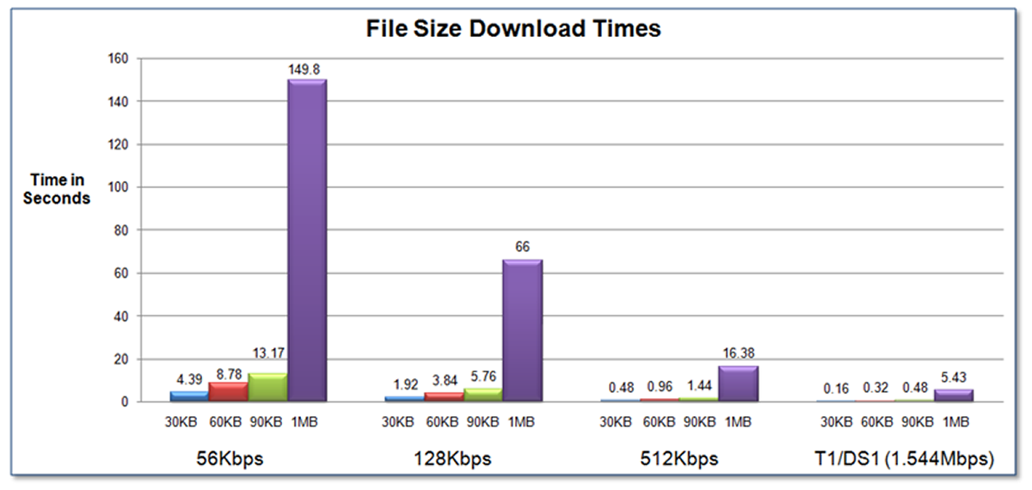
Web Page Design Load Time
Watch the load time of your pages
Try to limit web page document and associated media to under 60K on the home page

Slide 30
Web Page Design Browsers & Screen Resolution
Test with multiple browsers
Internet Explorer, Google Chrome, Mozilla Firefox, Apple Safari
Test at various screen resolutions
Design to look good at various screen resolutions
Centered page content
Set to either a fixed or percentage width

Slide 31
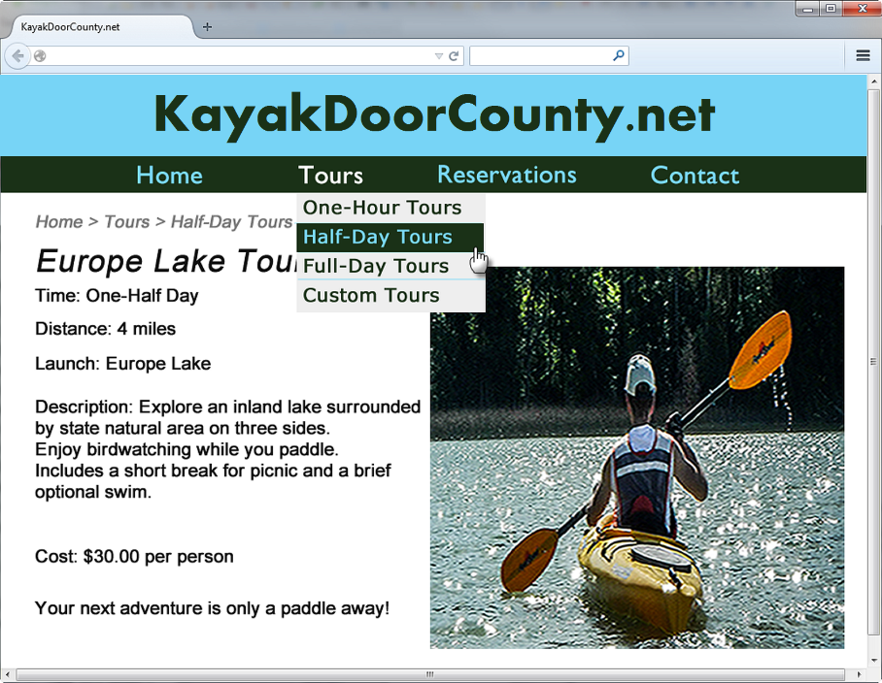
Navigation Design
Make your site easy to navigate
Provide clearly labeled navigation in the same location on each page
Most common – across top or down left side
Consider:
Navigation Bars
Breadcrumb Navigation
Using Graphics for Navigation
Dynamic Navigation
Site Search Feature
“Skip to Content” Hyperlink
--ARIA compliance

Slide 32
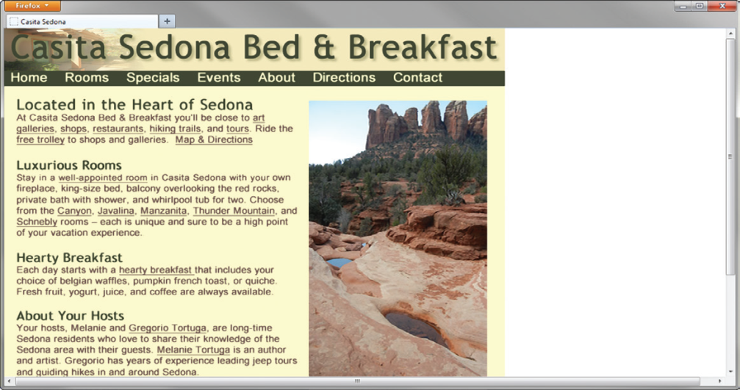
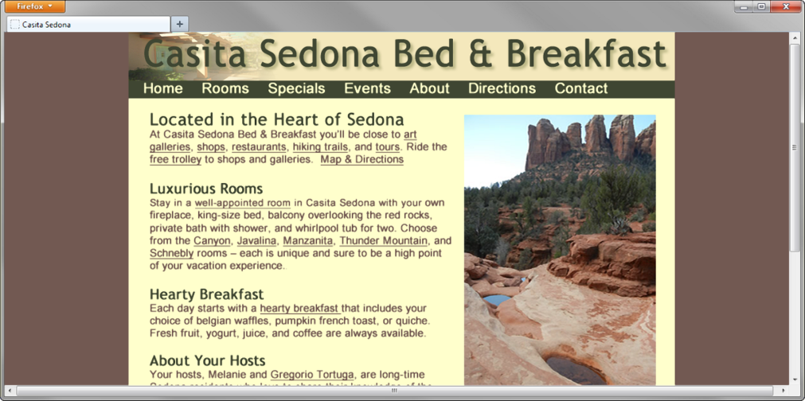
Page Layout Design Techniques
Fixed Layout
AKA rigid or “ice” design
Fixed-width often at left margin
Not appealing when there is a large amount of space on opposite side
More appealing if fixed with content is centered

Slide 33
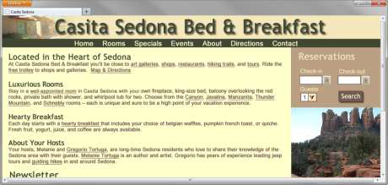
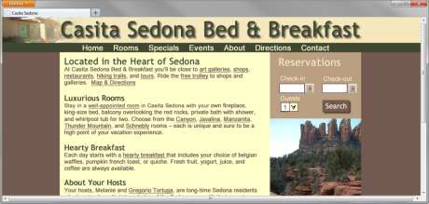
Page Layout Design Techniques
Fluid Layout
AKA “liquid” design
Expands to fill the browser at all resolutions.
Adaptation:
Page content typically centered and often configured with a percentage width such as 80%

